Slide 1
DFV Project Update
2020-01-18

Slide 2
Last Week’s Tasks
Collect Information About Previous Work
Develop DFV Formulation (personal)
Run SQED + Symbolic Starting States on V Scale
Port SQED + Symbolic Starting States to RideCore Design

Slide 3
Status Updates - Previous Work
Saranyu
Access to vscale SQED + Symbolic Starting States (SSS) Demo
+ Andy Bartolo - RSG Cluster Access
Florian + Caroline
Clarified status of current SSS constraints
Helped with DFV formulation
Eshan Singh
Gave historical background info + points of interest
Gave examples of spurious counterexamples on RideCore

Slide 4
Status Updates - DFV Formulation (Background)
SQED + SSS allows us to find very long sequence bugs (hardware trojans)
With SSS, tools may yield spurious counterexamples
We may have formulated a set of constraints that prevents them
C1/C2/C3 + A1/A2 in proof sketch
Found that this is effective for at least simple processor designs (vscale)

Slide 5
Status Updates - DFV Formulation
What if we have a design that does not necessarily meet these constraints?
Design is more complex (OOO, multi-instruction issue, multi-core, etc…)
We may get spurious counterexamples…
But - can we use them to guide hardware-level patching of the design?
Eliminating spurious counterexamples through RTL rather than formal tool constraints
Can become an automatic process
Can we use our minimum SSS constraints to inform these patches?
Can we formulate further constraints?
Verification engineers can choose to patch by RTL or patch by formal constraint

Slide 6
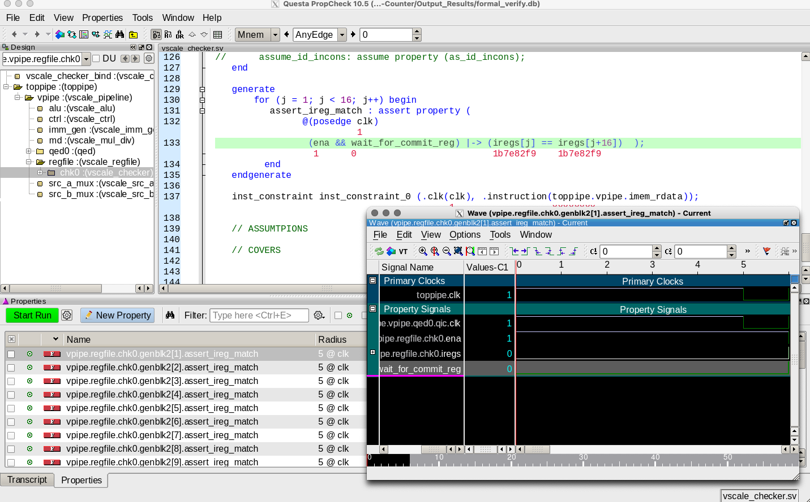
Status Updates - SQED + SSS Demo
Able to run all pre-existing scripts (compile -> prove -> visualize)

Slide 7
Status Updates - SQED + SSS Demo
Is there a repo containing SQED + SSS on RideCore?
Concerns about previously formulated SSS constraints
Is the A2 assumption too aggressive?
Basically assumes that RAW hazard forwarding logic is always correct
Seems to address the constraint to be proven in C3?

Slide 8
Upcoming Tasks
Understand toolchain used in SQED + SSS on vscale
Port SQED + SSS to RideCore
New QED module variant + recorders
Introduce hardware trojan variants
Collect spurious counterexamples
Collect spurious counterexamples
Reach out to automatic program repair folks

